Slide 1


Bootstrap 4 From Scratch With 5 Projects
Welcome To The Course

Slide 2
Welcome To The Course
This course was designed for people that..
Know nothing about Bootstrap
Know Bootstrap 3
Know Bootstrap 4 but want to learn more and build projects
Feel free to skip to section 6 to start the projects

Slide 3
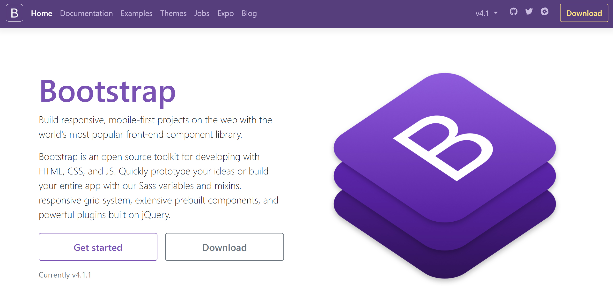
Complete Course Update: 6/2018
Latest version (4.1.1)
Course Upgraded From Beta
Complete Revamp
No NPM/Gulp

Slide 4
What You Should Know
HTML 5 Basics
Basic CSS
Very Basic JavaScript
Bootstrap 3 is a plus but NOT needed

Slide 5
What’s Included?
11 Sections
5 – 10 Lectures Per Section
5 Complete Front End Projects
All Code Included (Sandbox & Finished Projects)

Slide 6
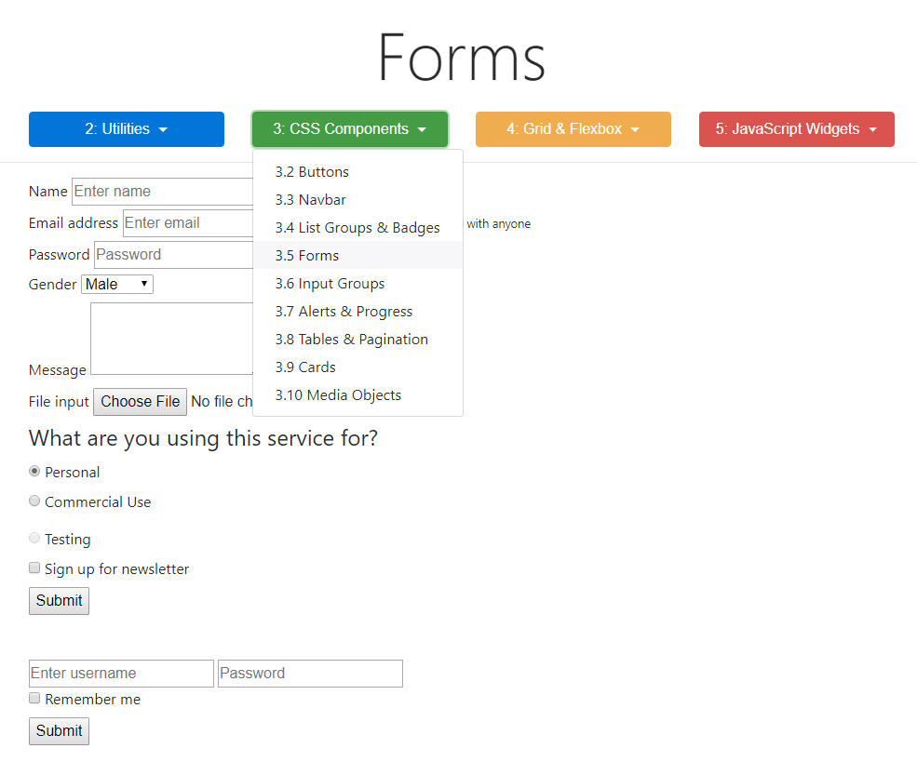
Using The Bootstrap Sandbox
Sections 2 - 5
Custom Learning UI
Code Along
Pure HTML Start State
Minimize Painful Typing
Excellent Completed Resource

Slide 7
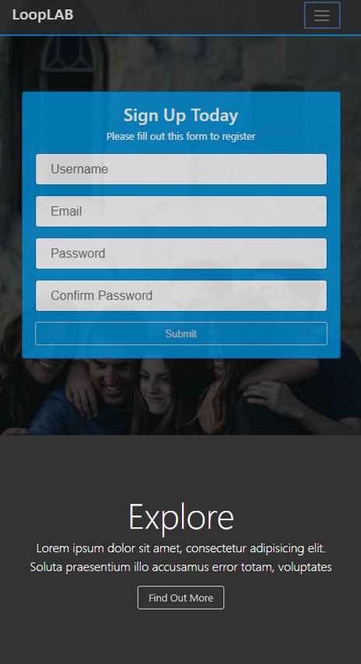
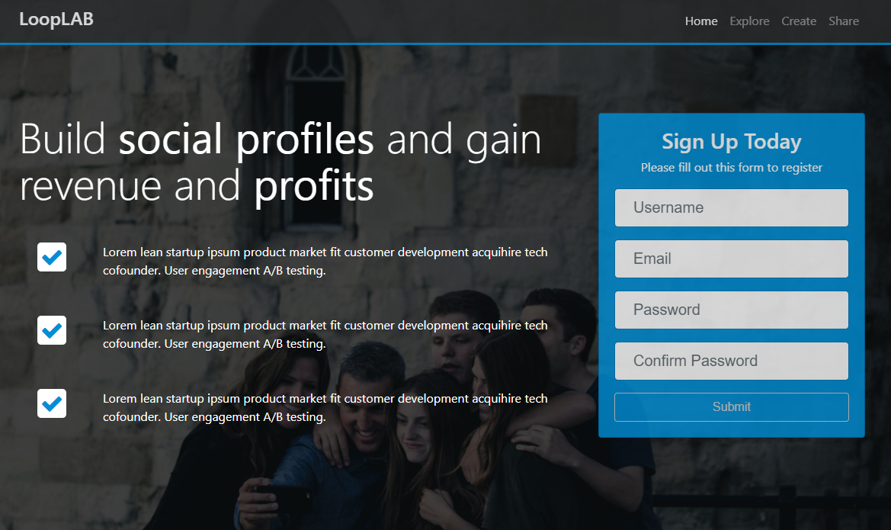
Project 1 - LoopLab

Slide 8
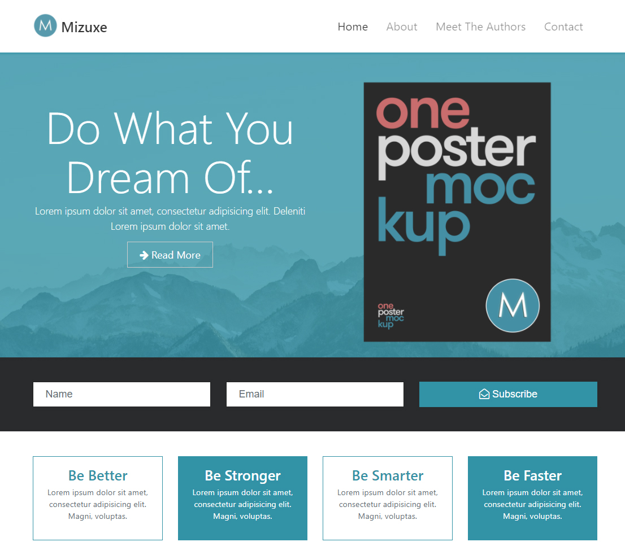
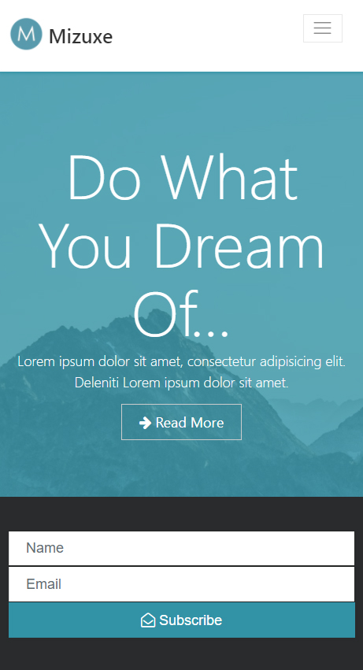
Project 2 - Mizuxe

Slide 9
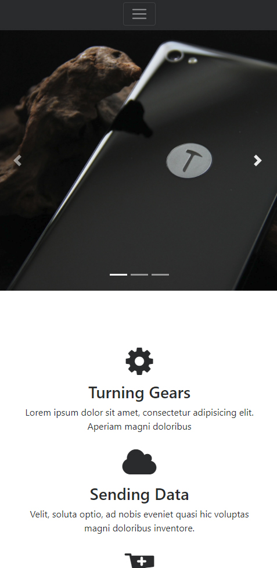
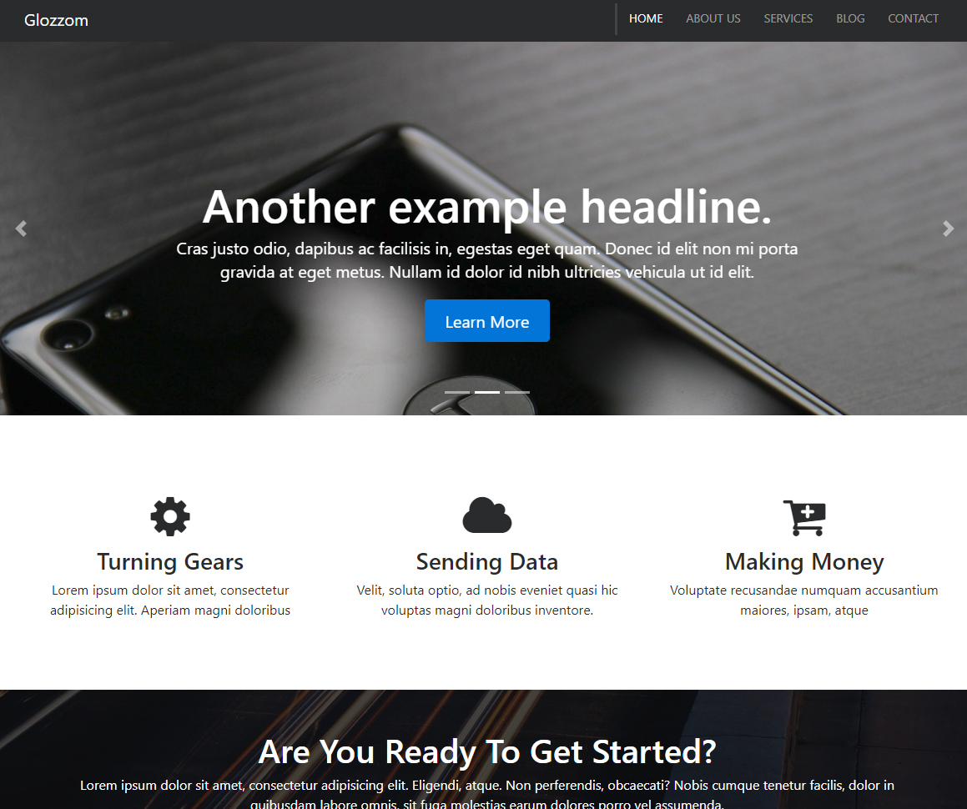
Project 3 - Glozzom

Slide 10
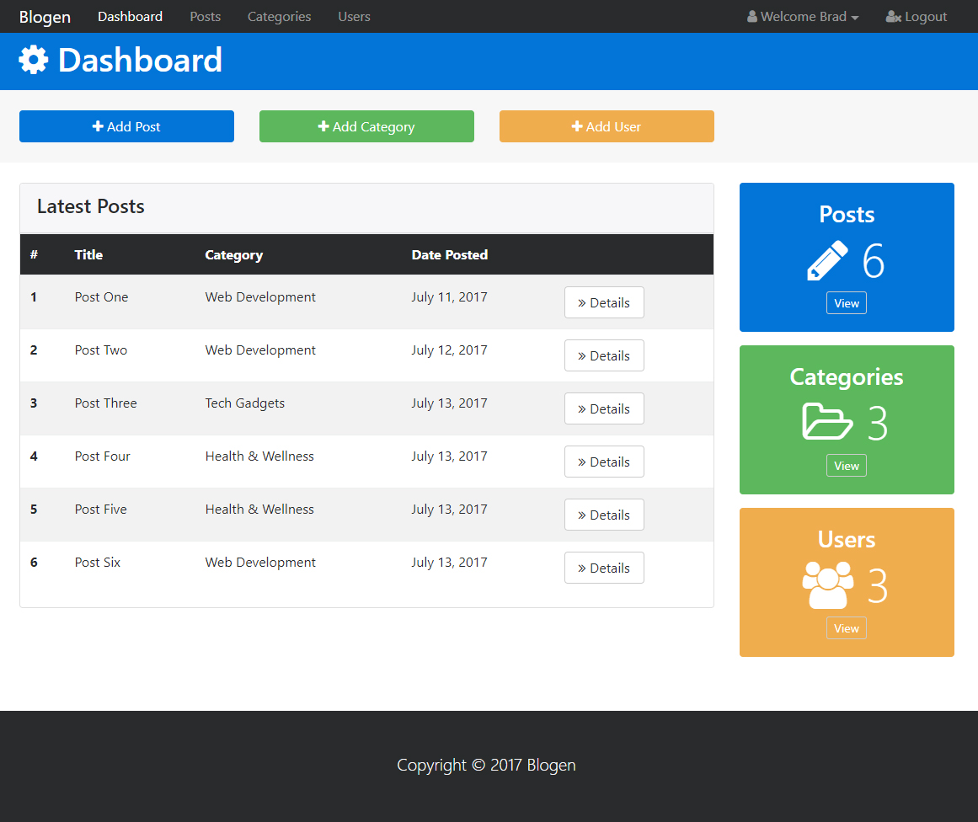
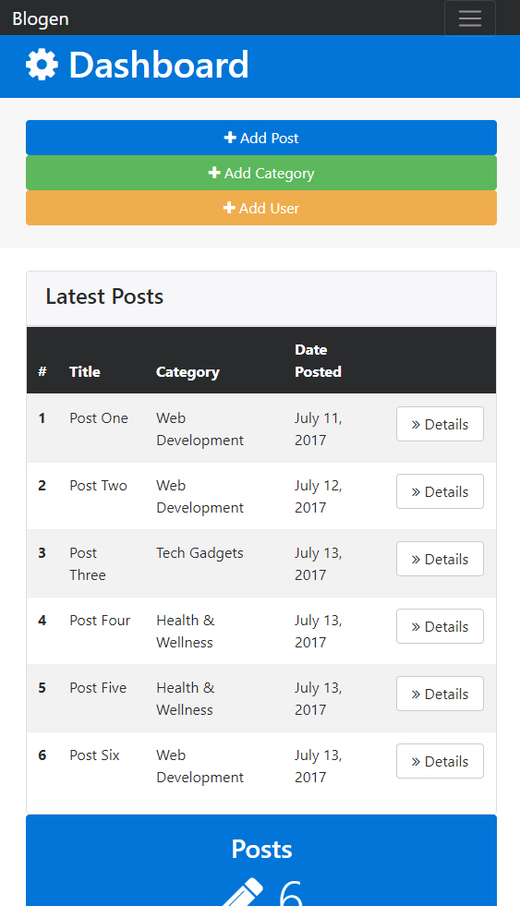
Project 4 - Blogen

Slide 11
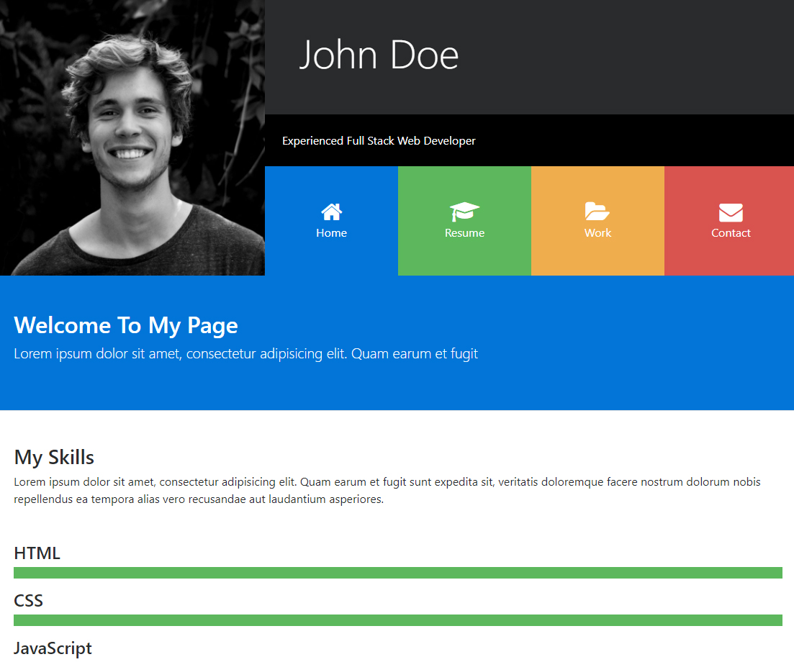

Project 5 – Portfolio Grid

Slide 12


FOLLOW BRAD:
Youtube.com/c/traversymedia
Facebook.com/traversymedia
Twitter.com/traversymedia
Linkedin.com/in/bradtraversy
Thank You
For Watching!
www.traversymedia.com

